Slide 1
Load backlog
Load education series 2025

Slide 2

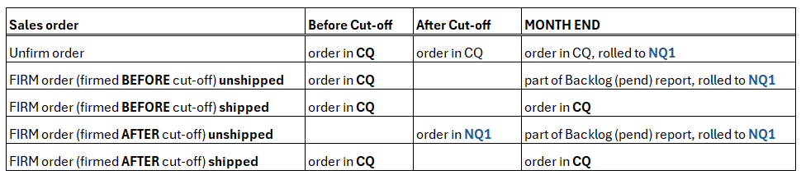
Load backlog
Backlog refers to all unshipped customer orders (requested to be shipped in current quarter) due to delays in production or delivery.
To predict quarterly revenue, the treatment for Power & Storage orders have been adjusted to account for the ‘lead time’ (estimated time from firming the order until shipping the order)
Different Lead time is set for 3 types of products:
HE (High End) products with 15 business days estimated lead time
HV (High velocity) products with 10 business working days estimated lead time
HV specials (Defend, CEPH, Clever) – with 50 business days estimated lead time
Lead times are regularly reconciled & might be updated based upon business changes.
Based on the lead time there is cut-off date (or LOED - Last Order Entry Date) set in Load data.
Cut-off for each power & storage order is set in columns:
FOP_CO_DTE (cut-off Backlog Date) with the actual cut-off date
BKLG_CAT_DTE (Backlog Category Date) with values CM – current month, NM – next month
Load treatment for Power & Storage orders CQ – Current quarter, NQ1 – next quarter
At Month End Final Backlog file is created by Supply Chain which contains all unshipped firm orders based on latest supply information.
At the beginning of the Next Quarter all unshipped orders (firm + unfirm) are rolled to Current Quarter.
When order is firmed AFTER cut-off Date, this order is moved to NQ1 & is not part of CQ Load valuation.
When this order is shipped still in CQ, it is moved back from NQ1 to CQ & is part of CQ Load valuation

Slide 3
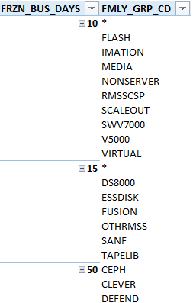
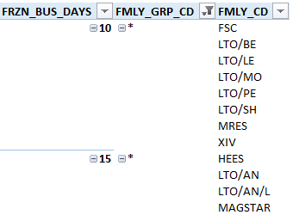
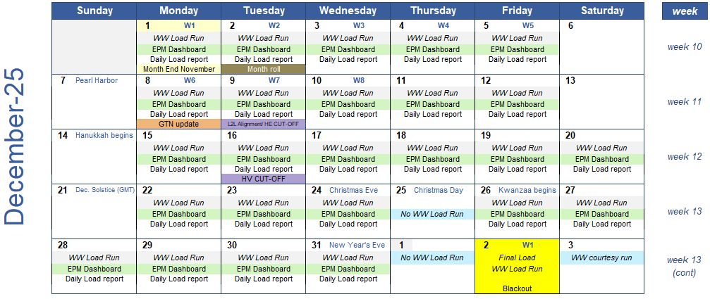
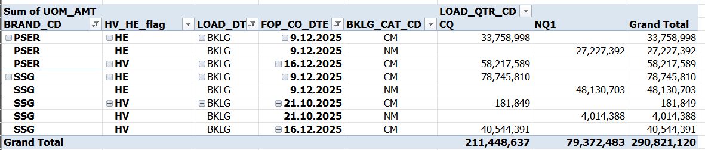
You can find the split to HE/HV Category in table FNP.WWLR_FRZN_BKLG. Split is done based on Family group code & Family code
Quarter Cut-off dates are in Load Calendar
Split to HE / HV Cut-off Date Load logic
Load Logic
Orders where backlog logic is applied are flagged as BKLG in column LOAD_DTE_METH_CD
Orders firmed BEFORE cut-off – reported still in CQ / CM
Orders firmed AFTER cut-off – reported in NQ1 / NM

